Slide 1
Digital Portfolio
STUDENT NAME: SWETHA.S
REGISTER NO: 24131210500122047
NMID:asanm121anm12124213045
DEPARTMENT: BCA
COLLEGE: COLLEGE/ UNIVERSITY
Notes:
Sweths

Slide 2
PROJECT TITLE:
SMART STUDENT PORTFOLIO SYSTEM

Slide 3


AGENDA
Problem Statement
Project Overview
End Users
Tools and Technologies
Portfolio design and Layout
Features and Functionality
Results and Screenshots
Conclusion
Github Link
3/21/2024 Annual Review

Slide 4
PROGRAM STATEMENT IN Project :
A program statement in a project typically outlines the purpose, goals, and objectives of the project. Here's a simple example:*Program Statement:
*"Develop a student portfolio website that effectively showcases academic projects, skills, and experiences, providing a platform for students to demonstrate their capabilities to potential employers
This statement clearly defines the project's purpose and objectives, serving as a guide for the development process.

Slide 5

PROBLEM STATEMENT: "Students lack a platform to effectively showcase their projects and skills to potential employers.

Slide 6

PROJECT OVERVIEW: 1*Create a student portfolio website to showcase projects, skills experiences. 2*Target Audience:* Students and potential employers.

Slide 7

TOOLS AND TECHNIQUES: 1. *HTML/CSS/JavaScript*: Essential tools for building websites and web applications. 2. *Design tools like Figma or Adobe XD*: Used for creating wireframes, prototypes, and visual designs.

Slide 8
WHO ARE THE END USER? . The primary users, who will create and manage their portfolios to showcase their work and skills. - *Potential Employers:* Recruiters, hiring managers, and other professionals who will view student portfolios to assess their qualifications and fit for job openings.

Slide 9
POTFOLIO DESIGN AND LAYOUT: 1. *Clean and Minimalist Design*: A simple, uncluttered layout that showcases work and skills. 2. *Visual Hierarchy*: Organizing content to draw attention to key projects andAchivemens.
9

Slide 10
FEATURES AND FUNCTIONALITy: 1. *Project Showcase*: A section to display projects with images, descriptions, and links. 2. *Skills and Experience*: A section to highlight skills, certifications, and work experience.

Slide 11
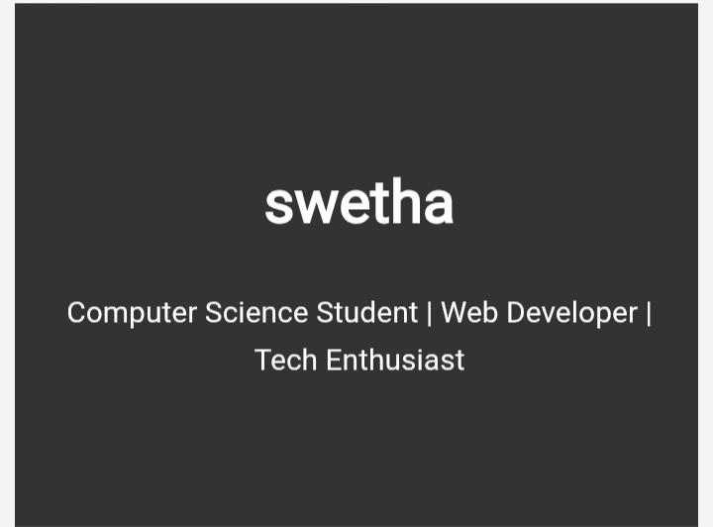
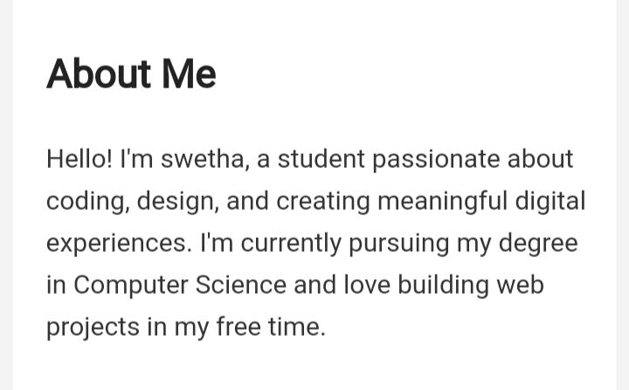
RESULTS AND SCREENSHOT

Slide 12
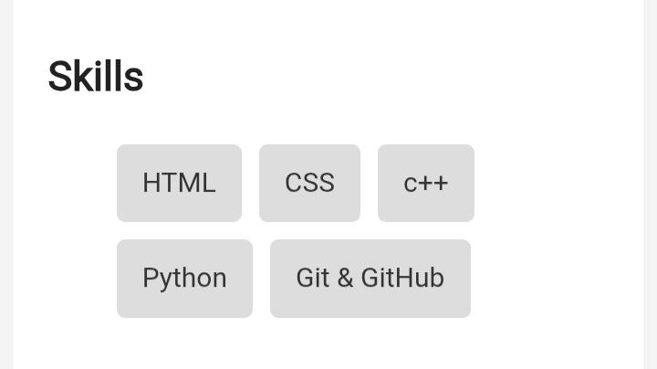
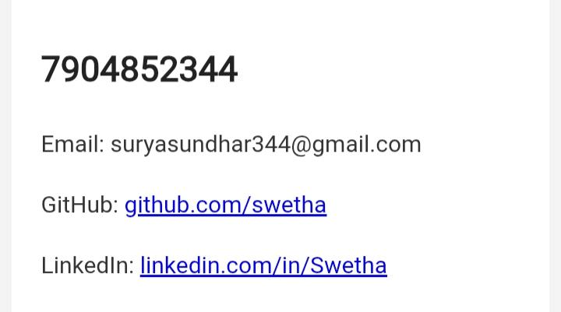

Slide 13
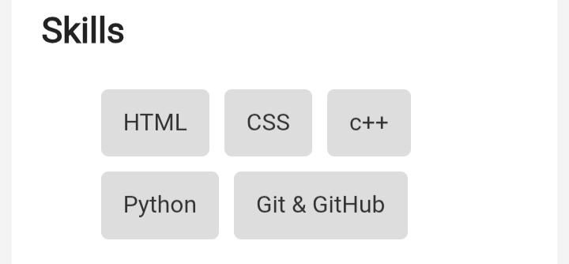

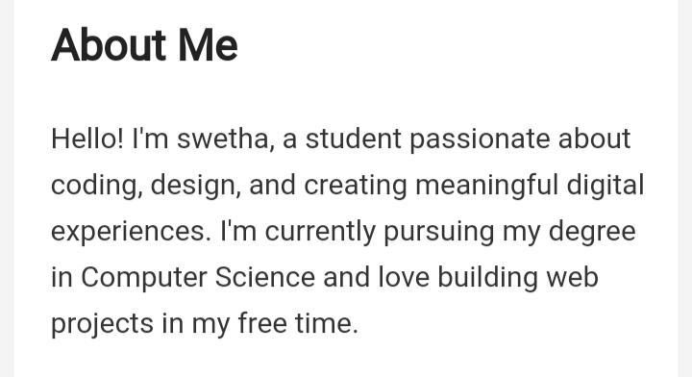
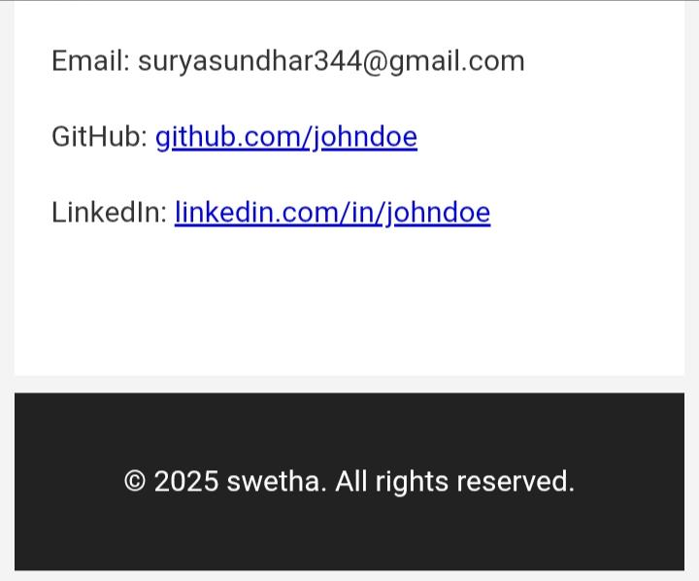
RESULTS AND SCREENSHOT

Slide 14
CONCLUSION
This portfolio reflects my growth, learning, and achievements throughout the [academic year/semester/project duration]. It showcases not only the skills and knowledge I have developed but also the challenges I have faced and how I have overcome them. Each piece included demonstrates my commitment to improving and pushing myself academically and personally.As I look back, I can see clear progress in areas such as [insert specific skills or subjects, e.g., writing, problem-solving, critical thinking, creativity, collaboration].

Slide 15
GITHUB
https://GitHub.com/

